Slide 1
Archery 101
Mitchell J & Ethan M
CSS 451

Slide 2
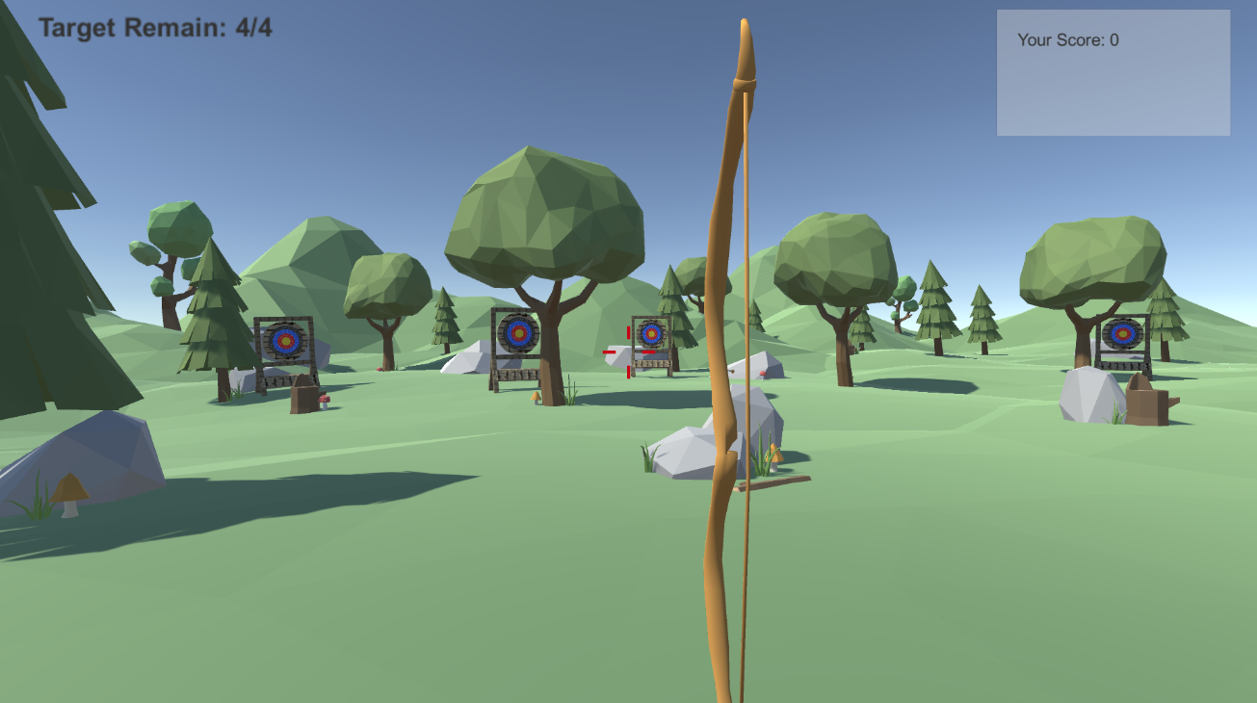
Archery game
Different explosion/hit effects when colliding with different parts of the target
Targets spin/rotate when hit with a projectile
Visible projectile arc using LineRenderer
Different bows with different horizontal arrow velocity
Horizontal velocity based on charging time
Multiple levels with moving targets
Visual aid made using free unity assets
We will design ours from scratch

Slide 3
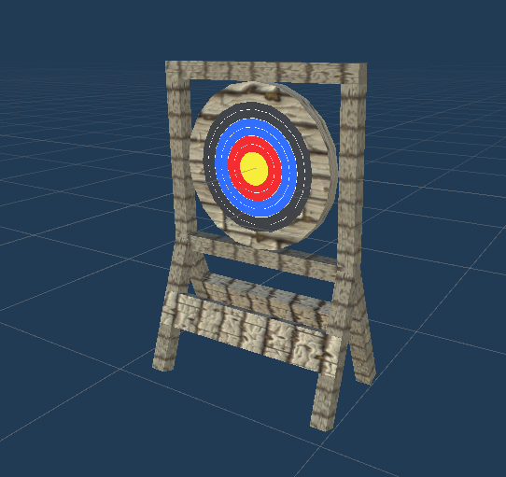
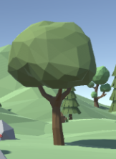
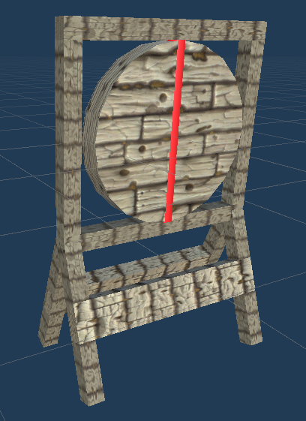

Project Requirements
SceneNode Hierarchy (at least 3 generations)
SceneNode: Target ( 3 generations)
Primitives: multiple rectangles forming structure
SceneNode: Central Axis
Primitives: cylinder
SceneNode: Rotatable plate
Primitives: flattened cylinder
SceneNode: Tree Target (3 generations)
Primitives: trunk, leaves
SceneNode: branches
Primitives: shapes making up branches
SceneNode: fruit
Primitives: red spheres or cylinders
Hitting the fruit will cause them to fall
All targets will can be directly manipulated in the same way in MP5 -> clicking and dragging/rotating

Slide 4
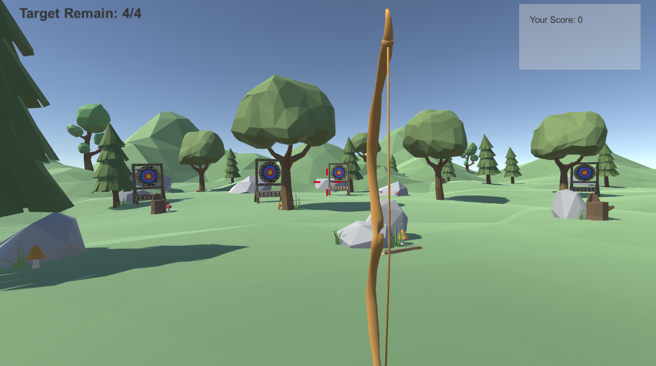
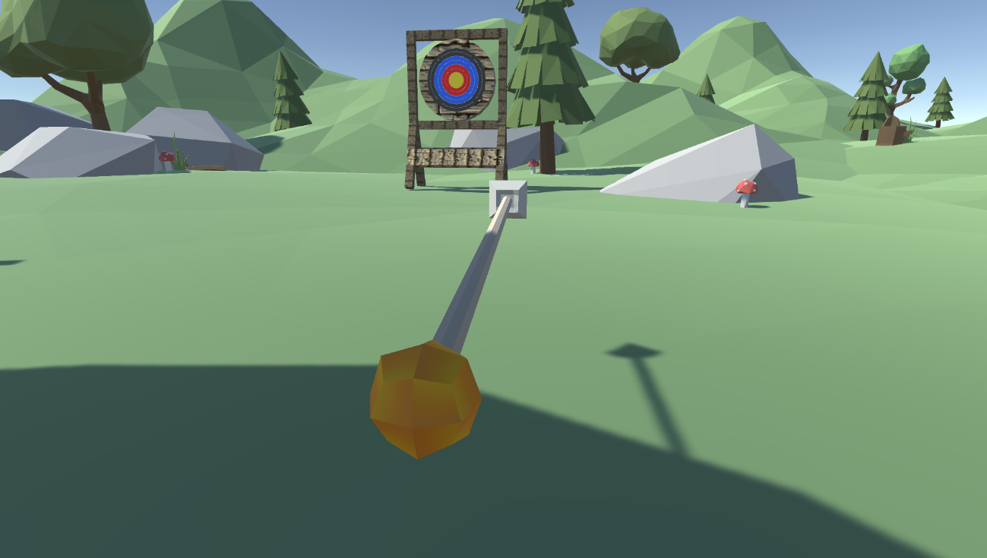
Project Requirements Cont.
Cameras
Shooter view (will follow mouse when right-mouse button is clicked) -> press left button to charge/fire
Arrow view (will fill entire viewport after arrow fires)
User will be able to zoom out and camera tumble while right mouse button is not clicked
User can also hold right mouse button and look around the scene
Object Interaction
Arrow hits targets -> increases score and spins/drops target/fruit (also some kind of particle effect)
Field and decorations
Shader
Target
Bow
Arrow
Tree
Constant sunlight
Scenery (rocks, grass, etc.)

Slide 5
Implementation plan
Weekly meetings
deadline | Task to complete
11/27 | - Travelling arrow with camera attached, with the correct projectile - Wrap targets in SceneNodes
12/5 | - Arrow/target interaction (target angular momentum/ friction) - render predicted projectile arc
12/8 | - bow charging product different velocity - target placement mode - main camera manipulation - shaders
12/11 | - finish up / bug fixing

